Slide 1
Analyzing Average Variation of Cell Areas in Voronoi Diagrams
James deLeon
July 31, 2025

Slide 2
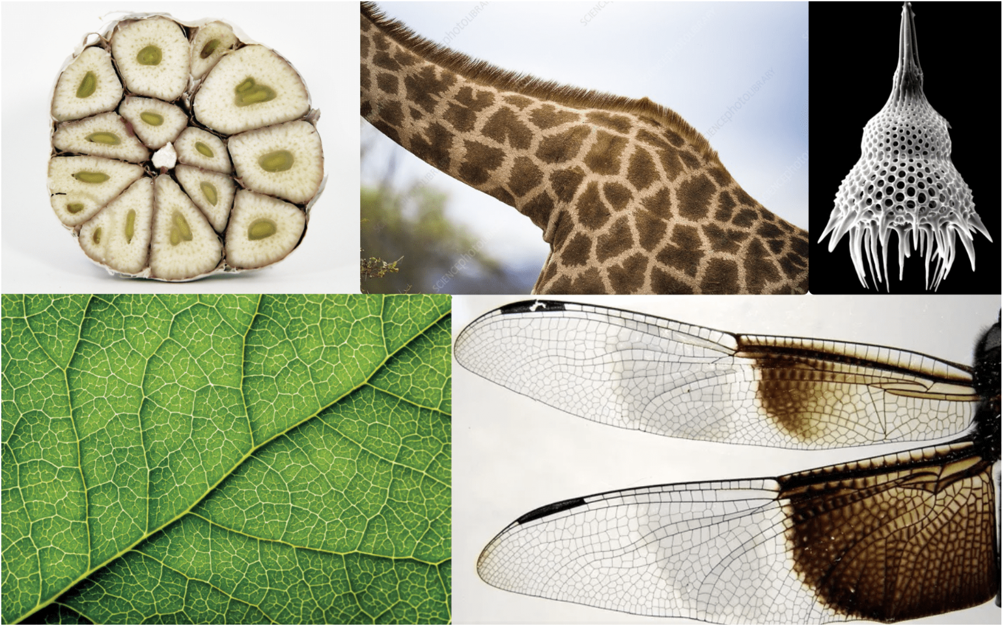
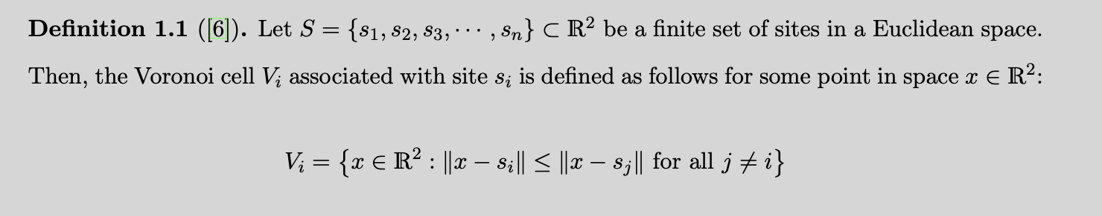
What are Voronoi Diagrams?
Voronoi Diagrams are tessellated geometric structures with a range of applications in geographical path finding, computer graphics, image approximation, and even solid-state physics.
These structures have the profile of non-overlapping convex polygons.

Slide 3
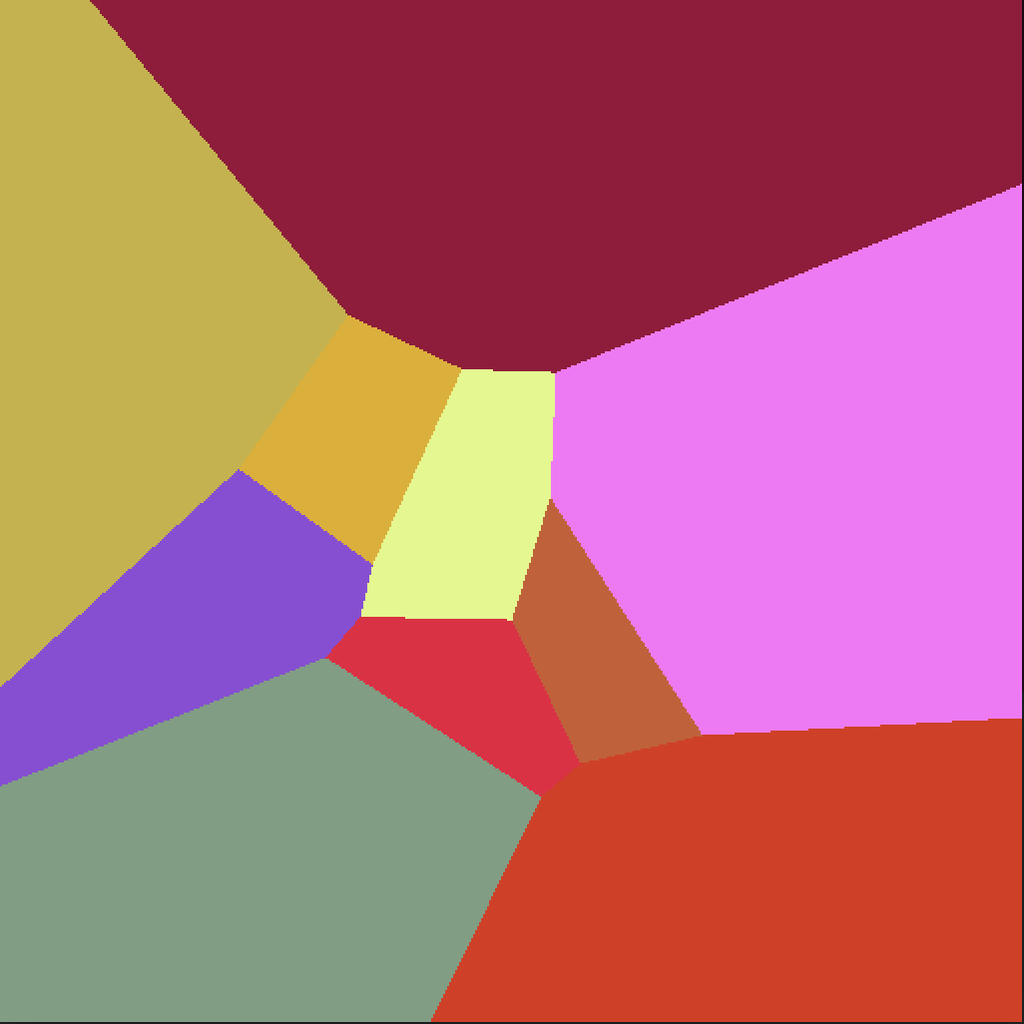
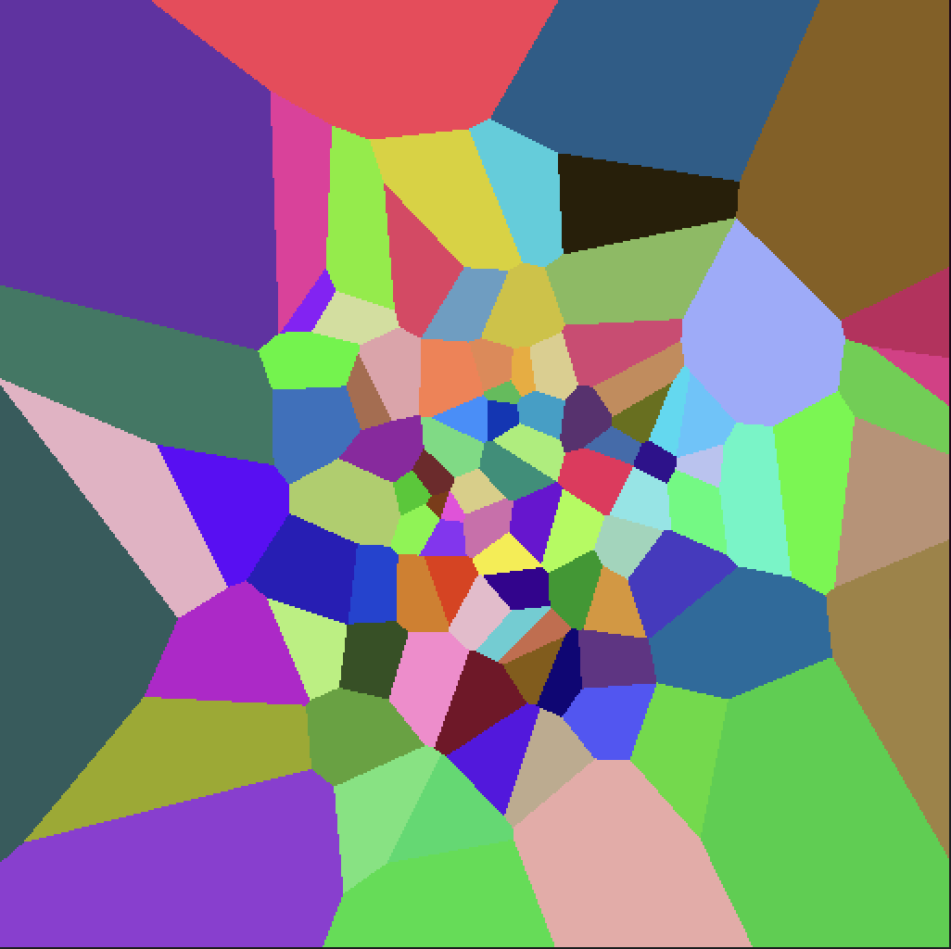
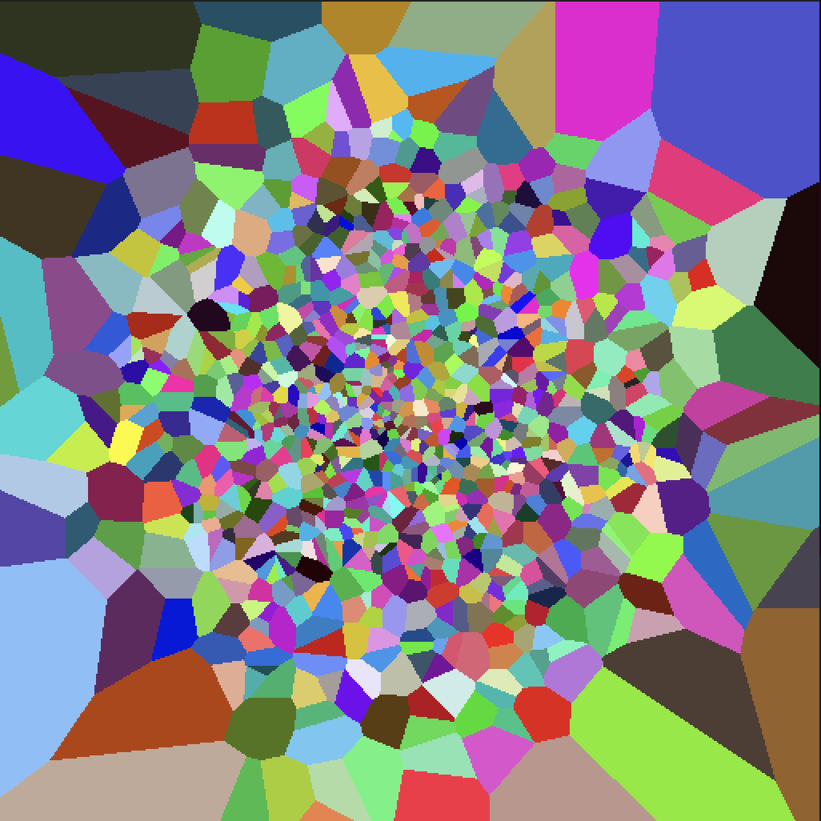
Normally Distributed Voronoi Diagrams
Voronoi Site Count: 10, 100, 1000

Slide 4
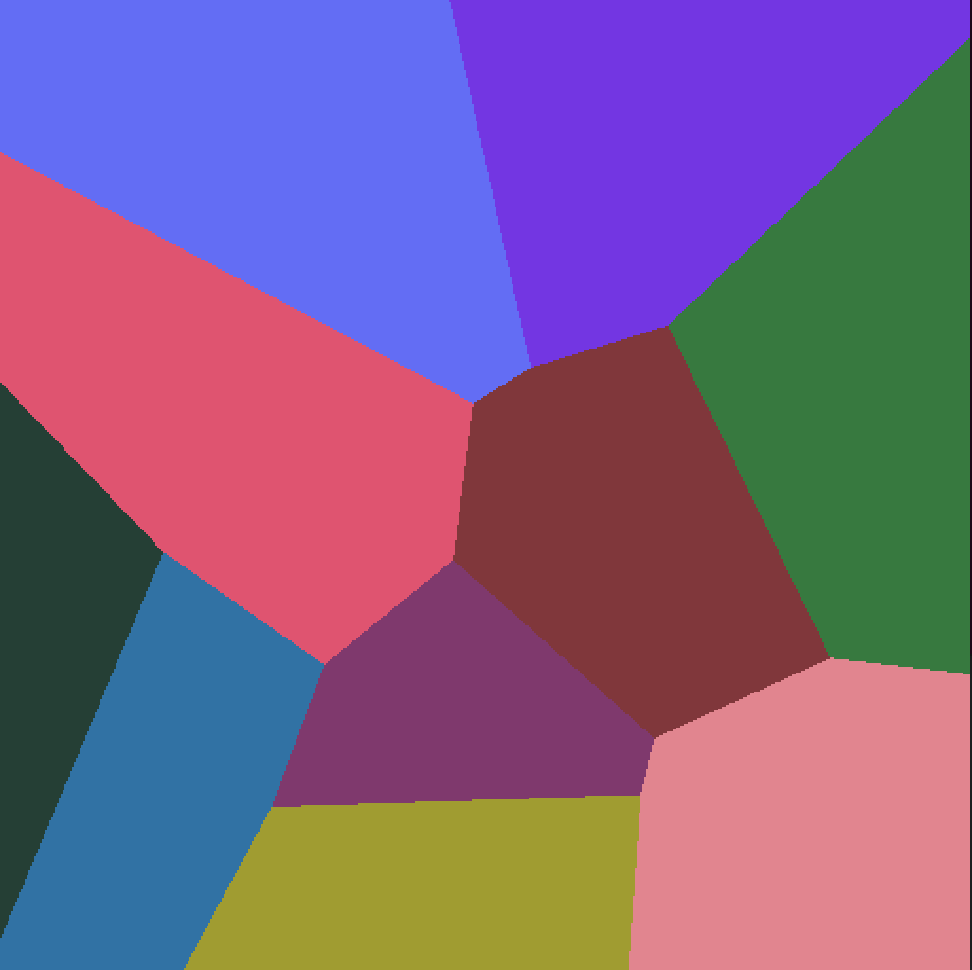
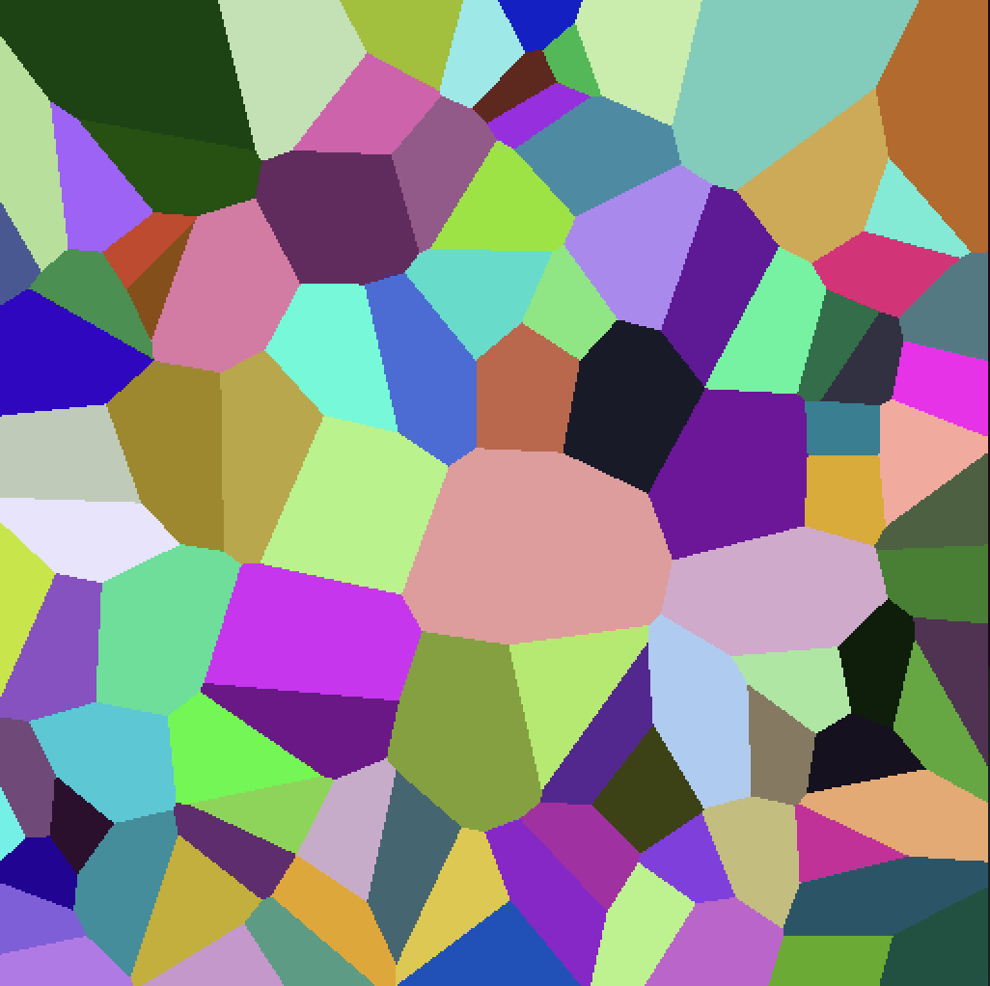
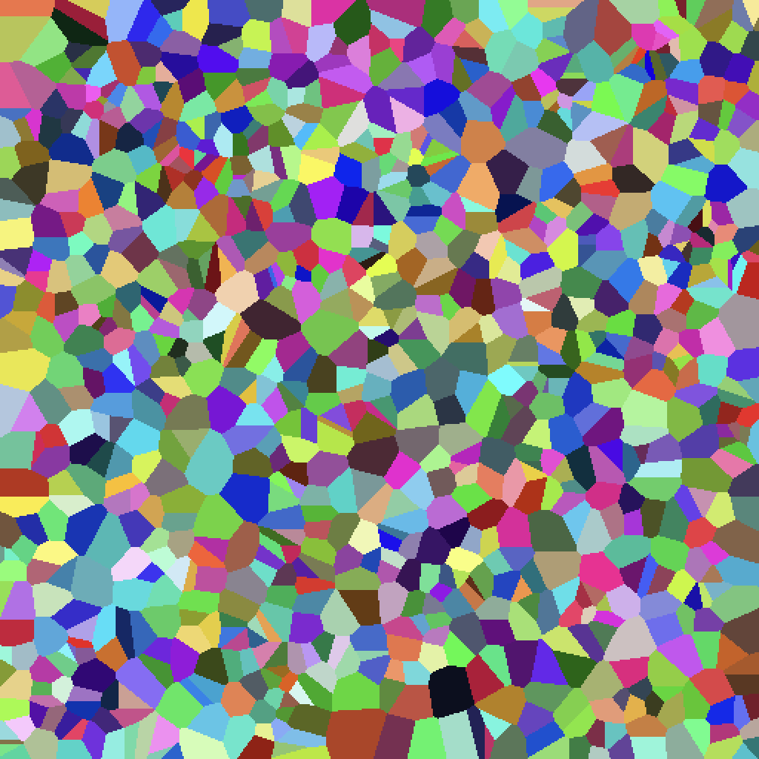
Uniformly Distributed Voronoi Diagrams
Voronoi Site Count: 10, 100, 1000

Slide 5
Research Question
Given two populations of distributions:
The population of Voronoi diagrams with Normally random sites
The population of Voronoi diagrams with uniformly distributed sites.
We want to measure the average variance between the two populations. Specifically, we want to measure the variation of cell areas between the two populations. This variation can be modelled as a random variable, as opposed to the average cell area, which is a deterministic measurement. For this experiment, we will be focusing on 512 x 512 pixel diagrams with p = 256 Voronoi sites.
This experiment proposes an alternative hypothesis with a significance level of 5% that the two populations of Voronoi diagrams have a different average variation in cell area. Let mu_1 denote the population average cell area variance for Normally distributed sites, and let mu_2 denote the population average cell area variance for Uniformly distributed sites.
H0: mu_1 - mu_2 = 0
Ha: mu_1 - mu_2 \= 0

Slide 6
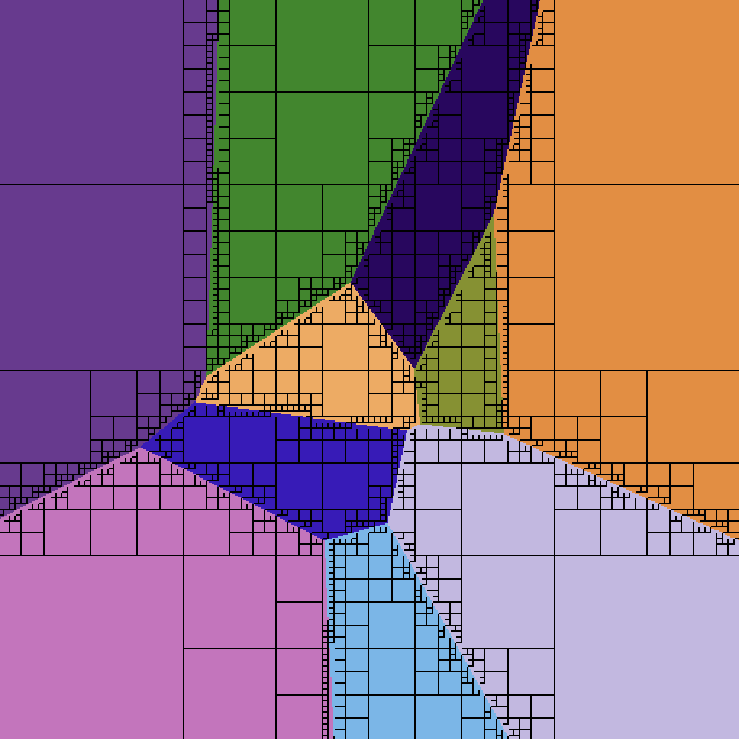
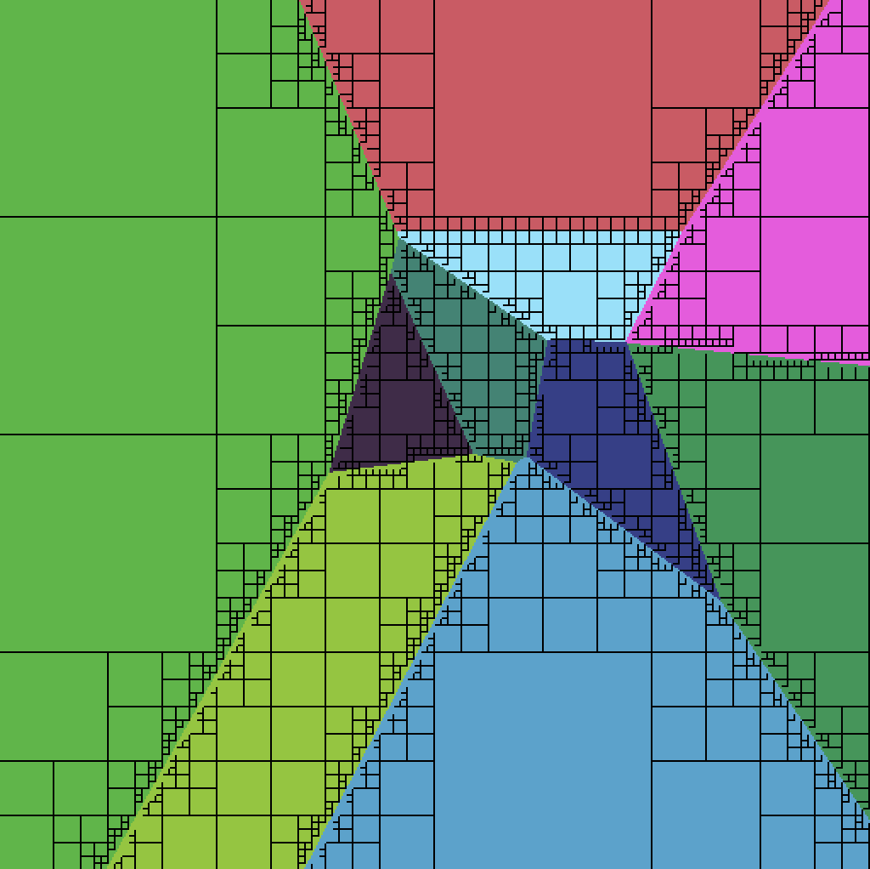
Methodology

Slide 7
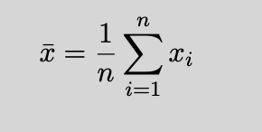
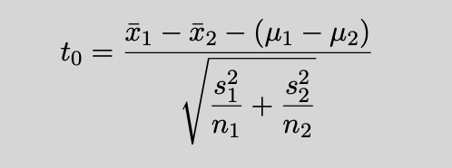
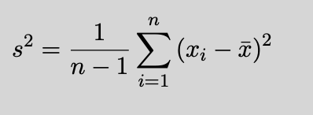
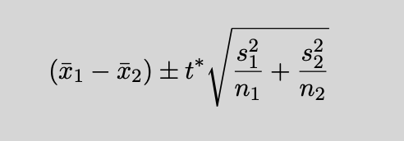
Methodology
We will use a divide-and conquer method to generate Voronoi diagrams using Quadtrees. The recursive properties of Quadtrees allow for us to assign sectors with a cell area. Altogether, we can tabulate the combined area for each Voronoi cell.
We will use a two-sample t-test to calculate our test statistics. For this experiment, we will have sample size of 1001 diagrams for each distribution

Slide 8
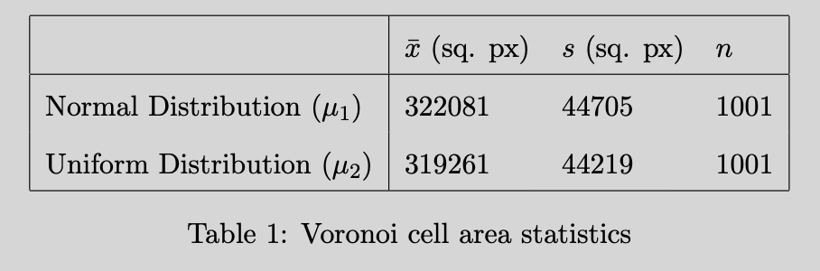
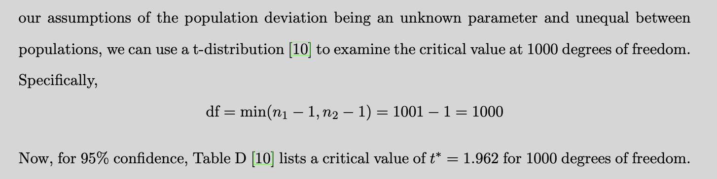
Results

Slide 9
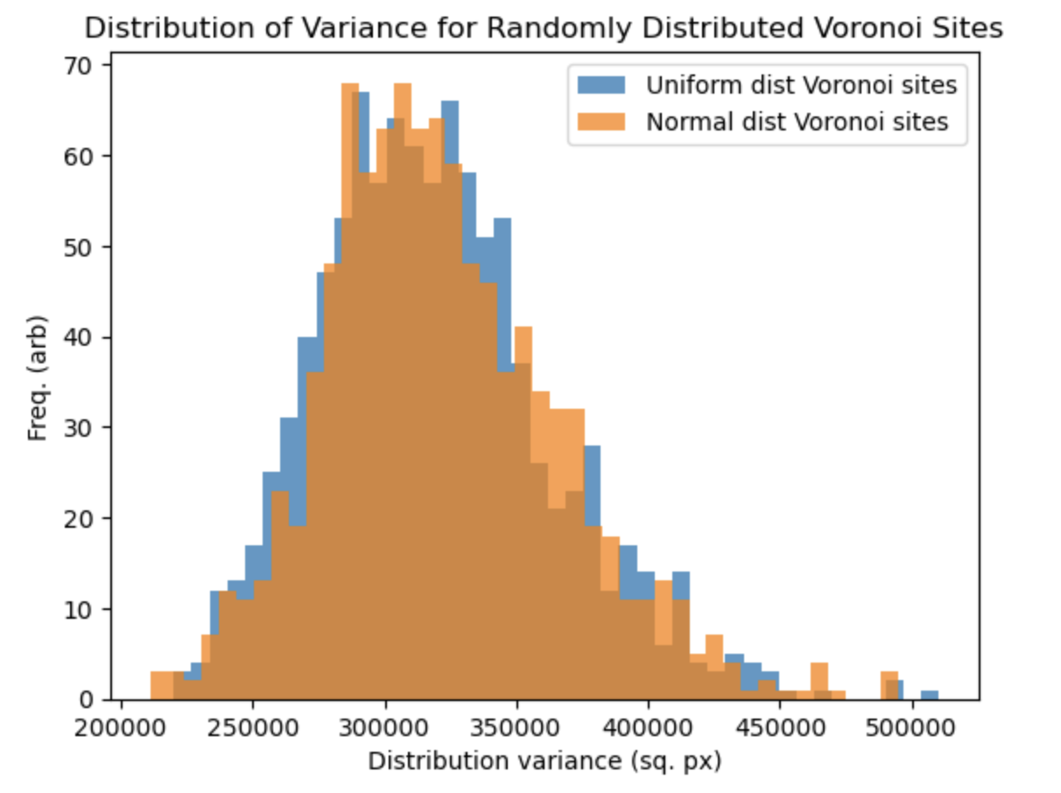
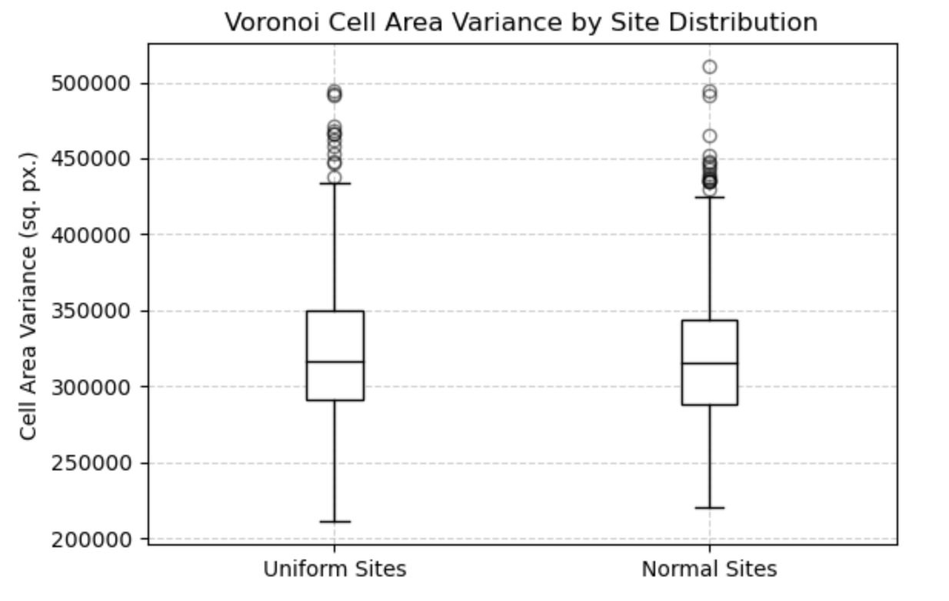
Results

Slide 10
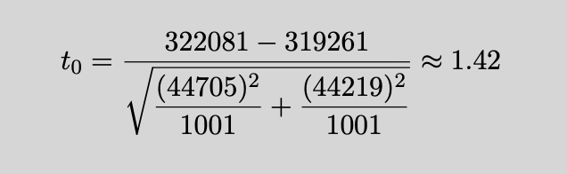
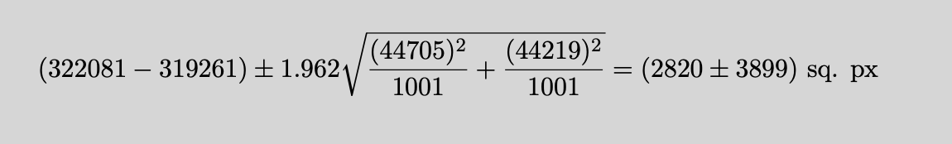
Results
This interval indicates that if we repeat this sampling process many times, then the true diﬀerence in
mean variance will be contained between -1079 sq. pixels and 6719 sq. pixels 95% of the time. The
lower bound extending into the negative region indicates that the Uniform distribution of Voronoi
sites presents a greater average variation of Voronoi cell areas, while the upper bound indicates a
greater average variation of cell areas from Normally distributed sites. This is not a good sign for
our significance test

Slide 11
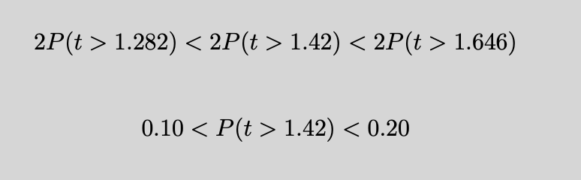
Results / Conclusion
We fail to reject the null hypothesis, since our approximate p-value is greater than our 5% significance level.
There is not enough evidence to suggest that there is a difference between uniformly distributed and Normally distributed sites in regards to cell area variation.

Slide 12
References
[1] Mark De Berg. Computational geometry: algorithms and applications. Springer Science & Business Media, third edition, 2000.
[2] Marcelo Walter, Alain Fournier, and Daniel Menevaux. Integrating shape and pattern in mammalian models. In Proceedings of the 28th annual conference on Computer graphics and interactive techniques, pages 317–326, 2001.
[3] Koichi Kise, Akinori Sato, and Motoi Iwata. Segmentation of page images using the area voronoi diagram. Computer Vision and Image Understanding, 70(3):370–382, 1998.
[4] Emanuel A Lazar, Jiayin Lu, and Chris H Rycroft. Voronoi cell analysis: The shapes of particle systems. American Journal of Physics, 90(6):469–480, 2022.
[5] Nisha Arya. A quick overview of voronoi diagrams, 2022.
[6] Adam Dobrin. A review of properties and variations of voronoi diagrams. Whitman College, 10(1.453):9156, 2005.
[7] Steven Fortune. A sweepline algorithm for voronoi diagrams. In Proceedings of the second annual symposium on Computational geometry, pages 313–322, 1986.
[8] Elijah Smith, Christian Treﬀtz, and Byron DeVries. A divide-and-conquer algorithm for computing voronoi diagrams. In 2020 IEEE International Conference on Electro Information Technology (EIT), pages 495–499. IEEE, 2020.
[9] Raphael A Finkel and Jon Louis Bentley. Quad trees a data structure for retrieval on composite keys. Acta informatica, 4(1):1–9, 1974.
[10] David S Moore, George P McCabe, and Bruce A Craig. Introduction to the Practice of Statistics. W.H Freeman, 9th edition, 2016.
[11] George EP Box and Mervin E Muller. A note on the generation of random normal deviates. The annals of mathematical statistics, 29(2):610–611, 1958.

